Slide 1
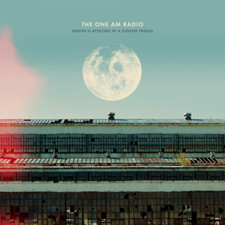

A City Without Seasons
The One AM Radio

